Slide 1

Hello CS109
CS 106B
Lecture 0
March 28th, 2016

Slide 2
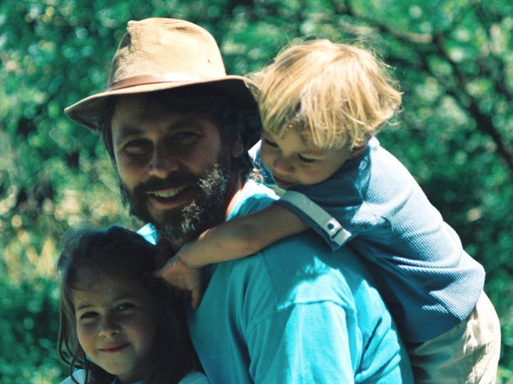
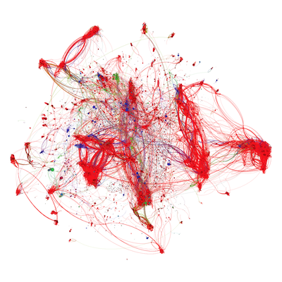

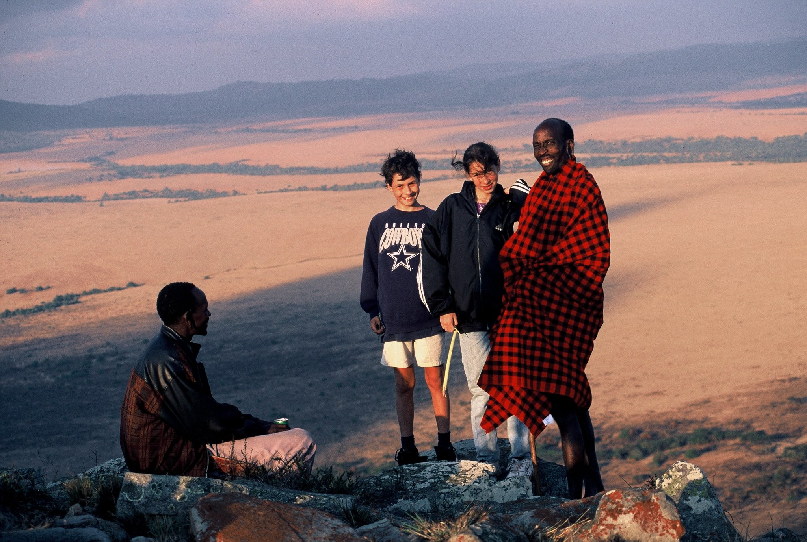
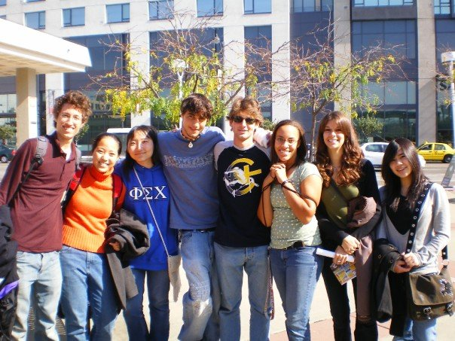
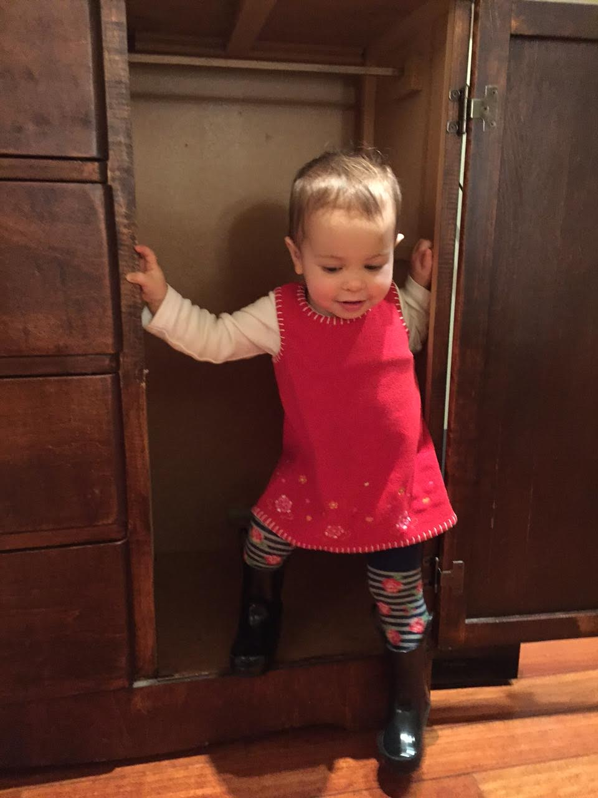
Hi, I’m Chris
Chris Piech (piech@cs.stanford.edu)

Slide 3
Who Are You?

Slide 4
Essential Information
cs109.stanford.edu

Slide 5
Prereqs
What you really need:
CS106B/X:
Recursion
Hash Tables
Binary Trees
Basic Programming
CS103:
Proof techniques (induction)
Set theory
Math 51 or CME 100
Multivariate differentiation
Multivariate integration
Basic facility with linear algebra (vectors)

Slide 6
Staff Contact
Post to Piazza
Go to Working Office Hours
Email cs109@cs.stanford.edu

Slide 7
How Many Units?
int numUnits(bool isGrad, bool wantsFewerUnits) {
if (!isGrad) return 5;
if (!wantsFewerUnits) return 5;
if (reallyWantFewerUnits()) {
return 3;
} else {
return 4;
}
}

Slide 8
Class Breakdown
45%
6 Assignments
20%
Midterm
Tuesday May 3rd, 7-9pm
35%
Final
Monday June 6th
5%
Lecture Participation

Slide 9
Late Days
2

Slide 10
Honor Code
You can talk to your friends
Cite your group
Don’t look up solutions

Slide 11
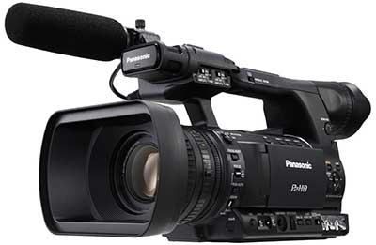
Video Taped

Slide 12
Story of Modern AI

Slide 13
What does it take to make a robot?

Slide 14
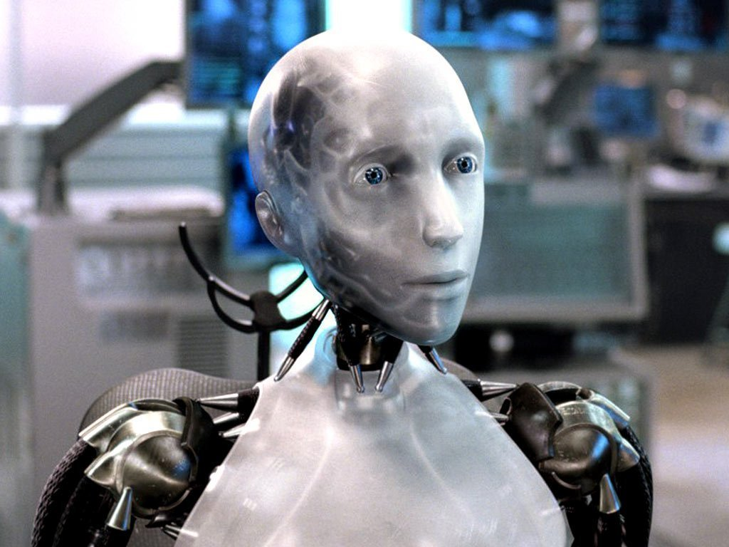
Sci-Fi Has Promised Me Robots

Slide 15
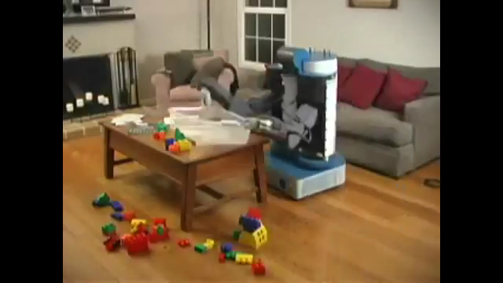
House Cleaning Robot

Slide 16
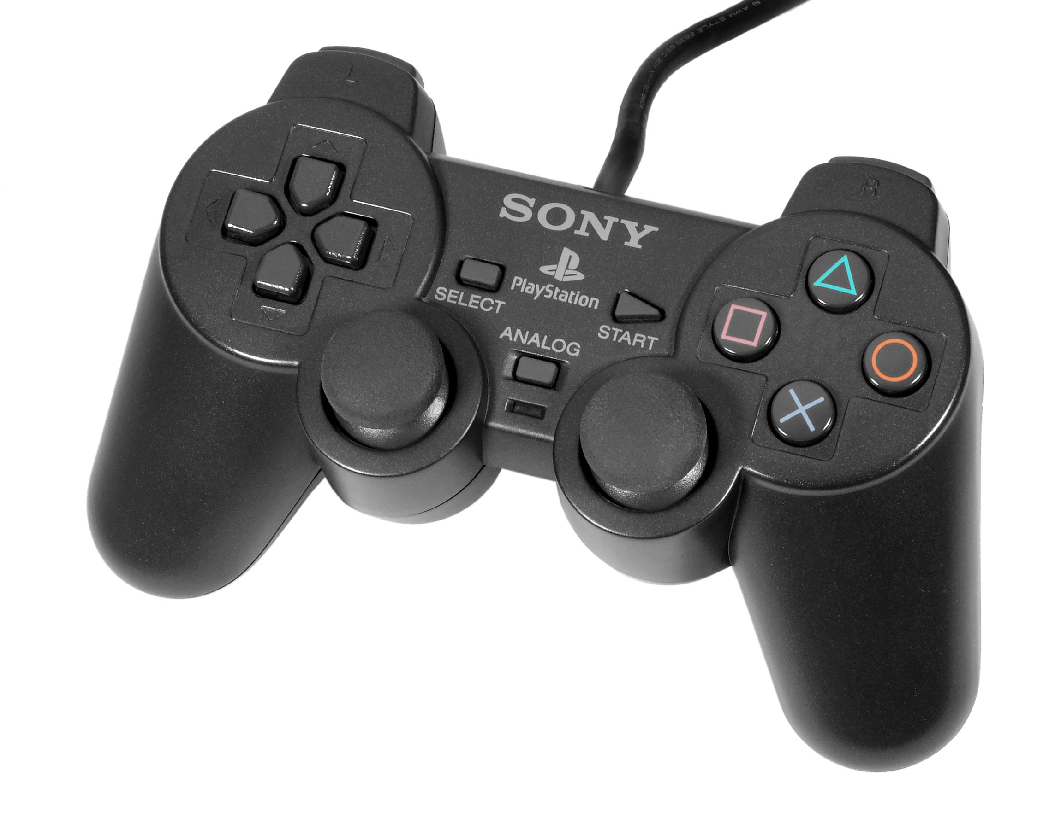
House Cleaning Robot

Slide 17
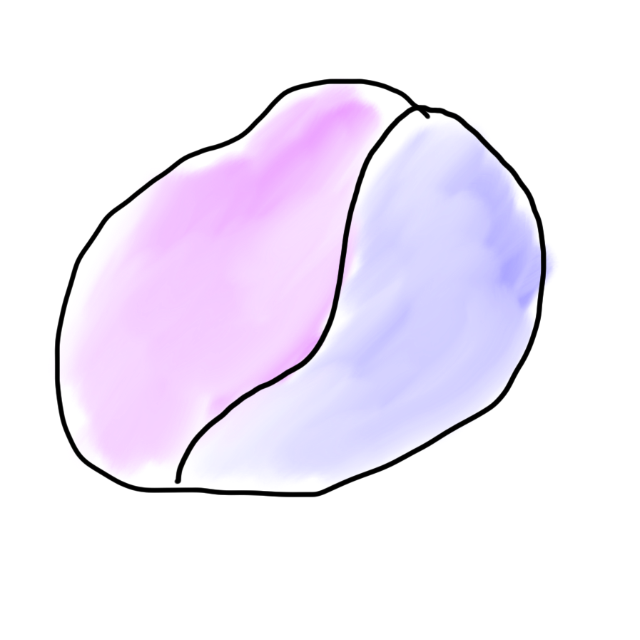
Robots?
Mind
Body

Slide 18

Robots?
Mind
Body

Slide 19
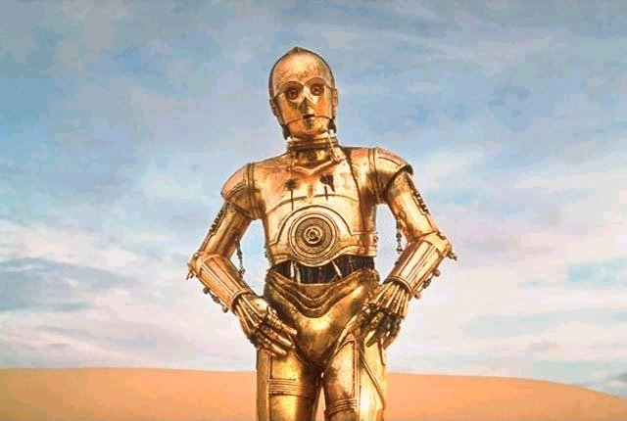
Brief History

Slide 20
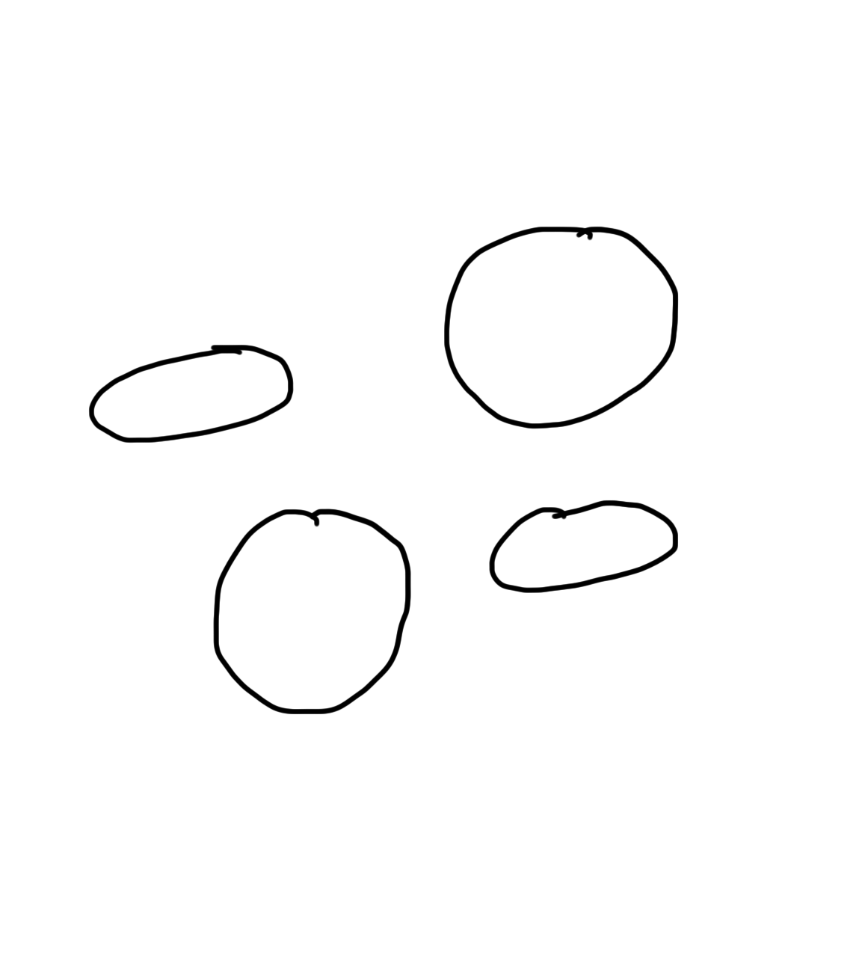
Narrow Intelligence
Translate
Turkish
Play Chess
Play Breakout
Drive a
Car

Slide 21
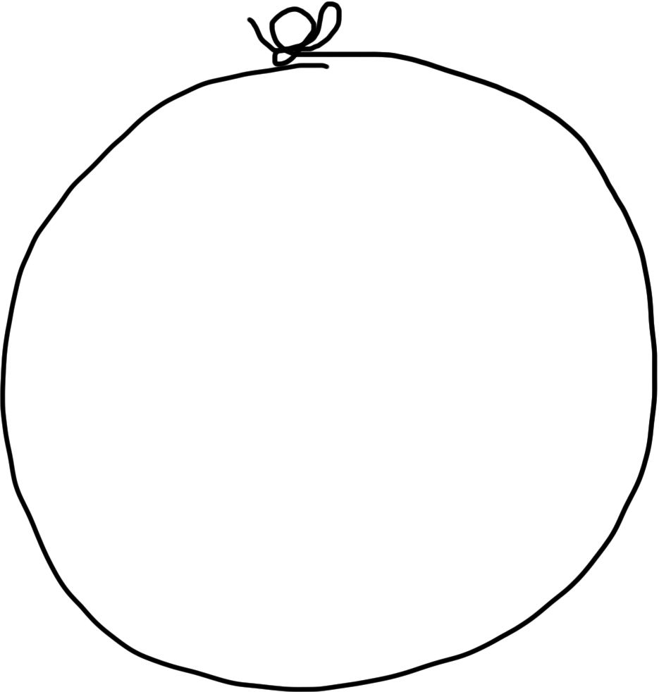
General Intelligence
Translate
Turkish
Play Chess
Play Breakout
Drive a
Car

Slide 22
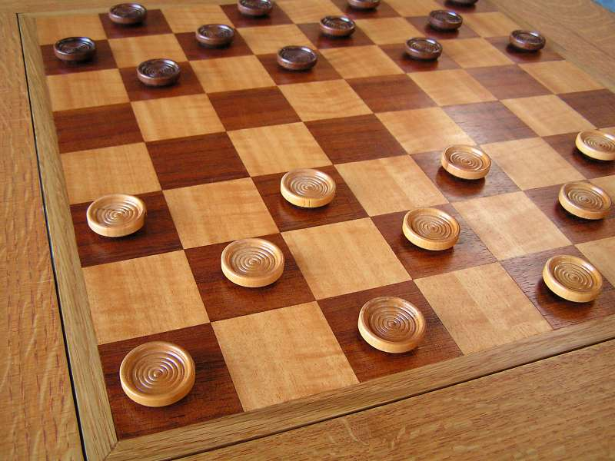
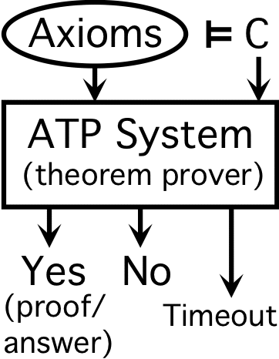
Early Optimism 1950
1952
1955

Slide 23
Early Optimism 1950
“Machines will be capable, within twenty years, of doing any work a man can do.”
–Herbert Simon, 1952

Slide 24
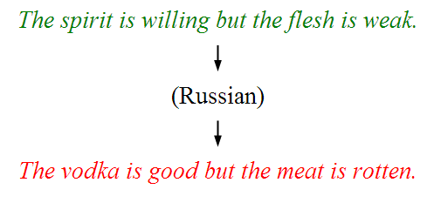
Underwhelming Results 1950s to 1980s
The world is too complex

Slide 25


Slide 26
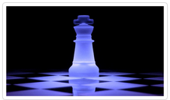
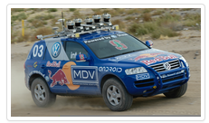

Big Milestones Pt 1
1997 Deep Blue
2005 Stanley
2011 Watson

Slide 27


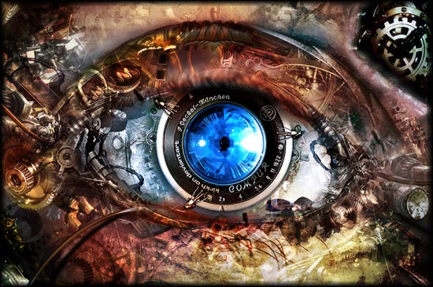
Big Milestones Pt 2

Slide 28
Told Vision Was 30 Years Out

Slide 29
Told Speech Was 30 Years Out
Almost perfect…

Slide 30
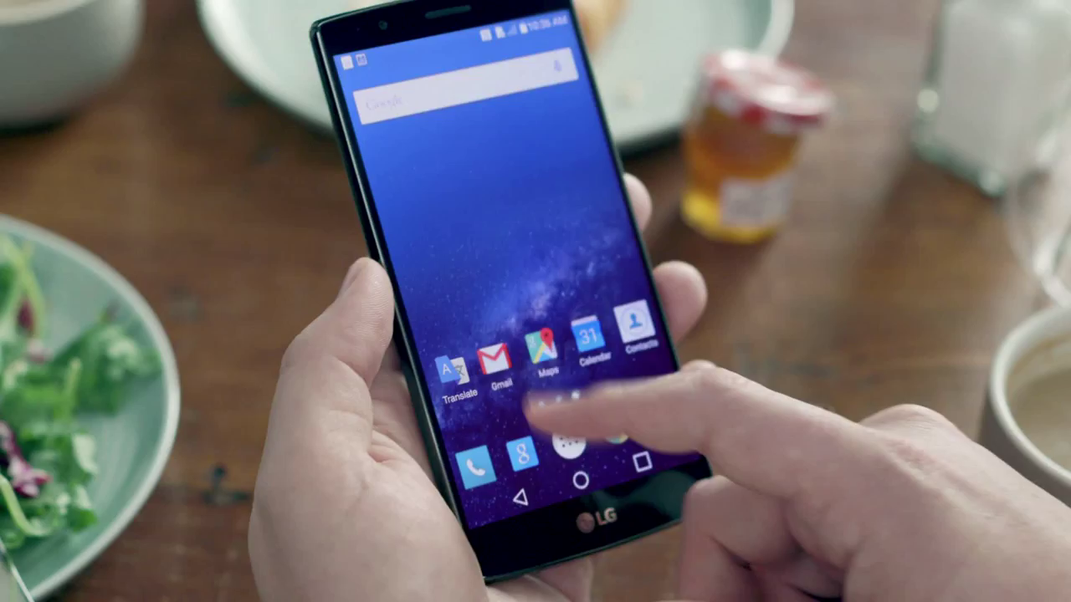
Huge Progress

Slide 31

Passed the Turing Test?
33% of judges thought Eugene was a human
When only given 5 minutes…

Slide 32
What is going on?

Slide 33
Story of Modern AI

Slide 34
Two Great Ideas
1. Probability from Examples
2. Artificial Neurons

Slide 35
Two Great Ideas
1. Probability from Examples
2. Artificial Neurons

Slide 36
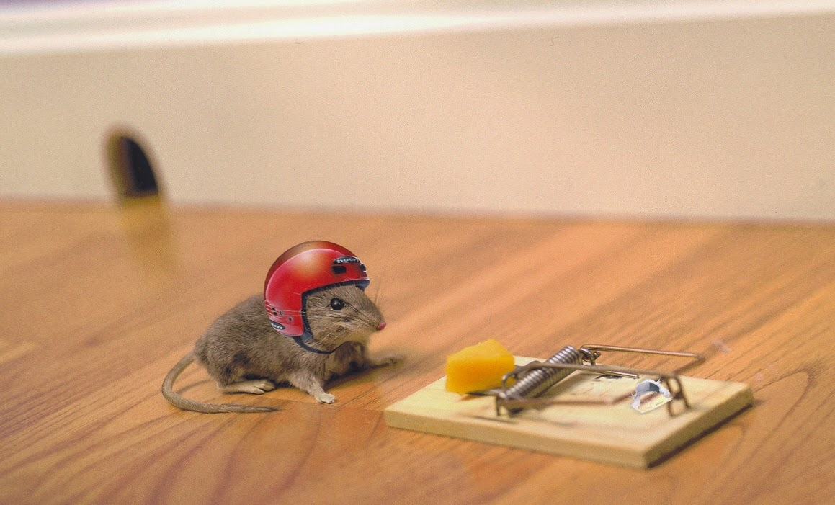
1. Probability From Examples

Slide 37
When Does the Magic Happen?
Lots of Data
Sound
Probability
+

Slide 38
Machine Learning
Basically just a rebranding of statistics and probability.

Slide 39
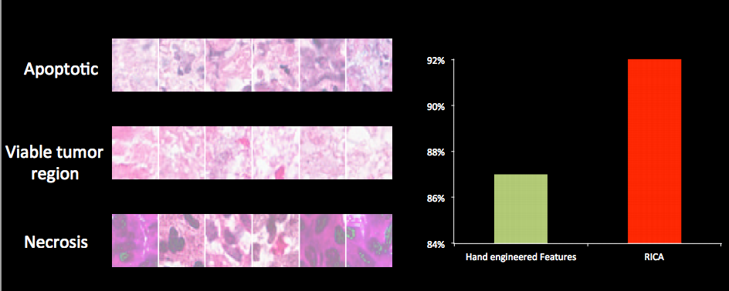
Vision: Detect Cancer
Accuracy
2010
Current

Slide 40

Vision: Detect Digits

Slide 41
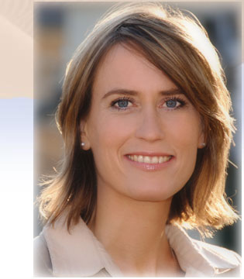


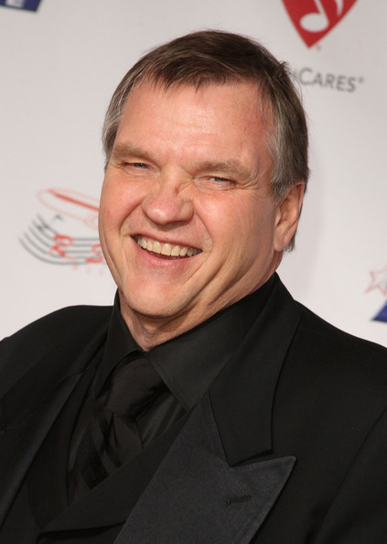
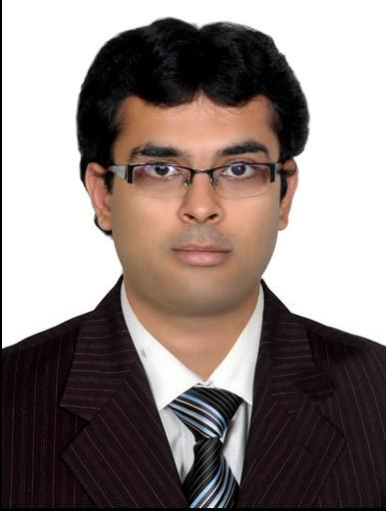
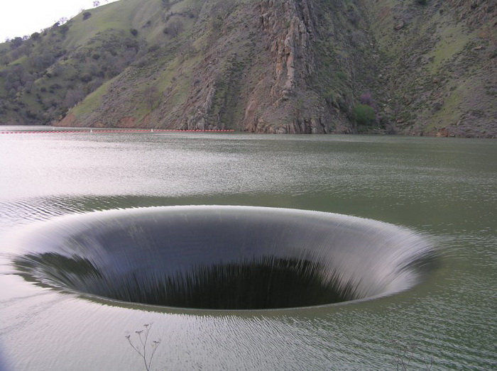
Vision: Detect Faces

Slide 42
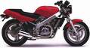
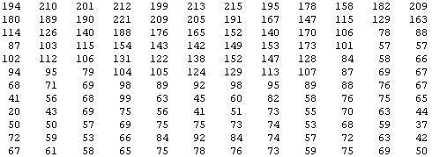
Why is this hard?
Vision is Hard
[
You see this:
But the camera sees this:
[Andrew Ng]

Slide 43
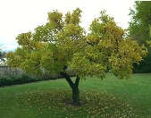
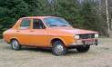

Feature representations
Machine Learning
pixel 1
Learning
algorithm
pixel 2
Input
Motorbikes
Raw image
“Non”-Motorbikes
pixel 2
pixel 1

Slide 44
Feature Representations
Machine Learning
pixel 1
Learning
algorithm
pixel 2
Input
Motorbikes
Raw image
“Non”-Motorbikes
pixel 2
pixel 1

Slide 45
Feature Representations
Machine Learning
pixel 1
Learning
algorithm
pixel 2
Input
Motorbikes
Raw image
“Non”-Motorbikes
pixel 2
pixel 1

Slide 46
What we want
Machine Learning
handlebars
Feature representation
Learning
algorithm
wheel
Input
E.g., Does it have Handlebars? Wheels?
Motorbikes
Raw image
“Non”-Motorbikes
Features
pixel 2
Wheels
pixel 1
Handlebars

Slide 47
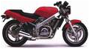








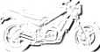







Human Features
Human Created Features
0.1
0.7
0.4
0.6
0.1
0.7
0.4
0.6
0.1
0.4
0.5
0.5
…
0.1
0.4
0.5
0.5
0.1
0.6
0.5
0.7
0.2
0.3
0.4
0.4
Final
feature
vector
Find edges
at four
orientations
Sum up edge
strength in
each quadrant
[Andrew Ng]

Slide 48
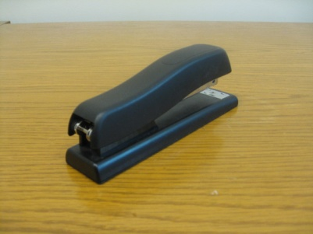
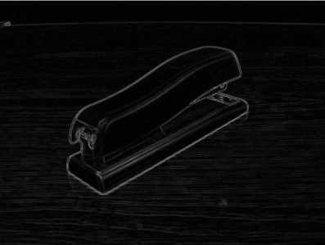




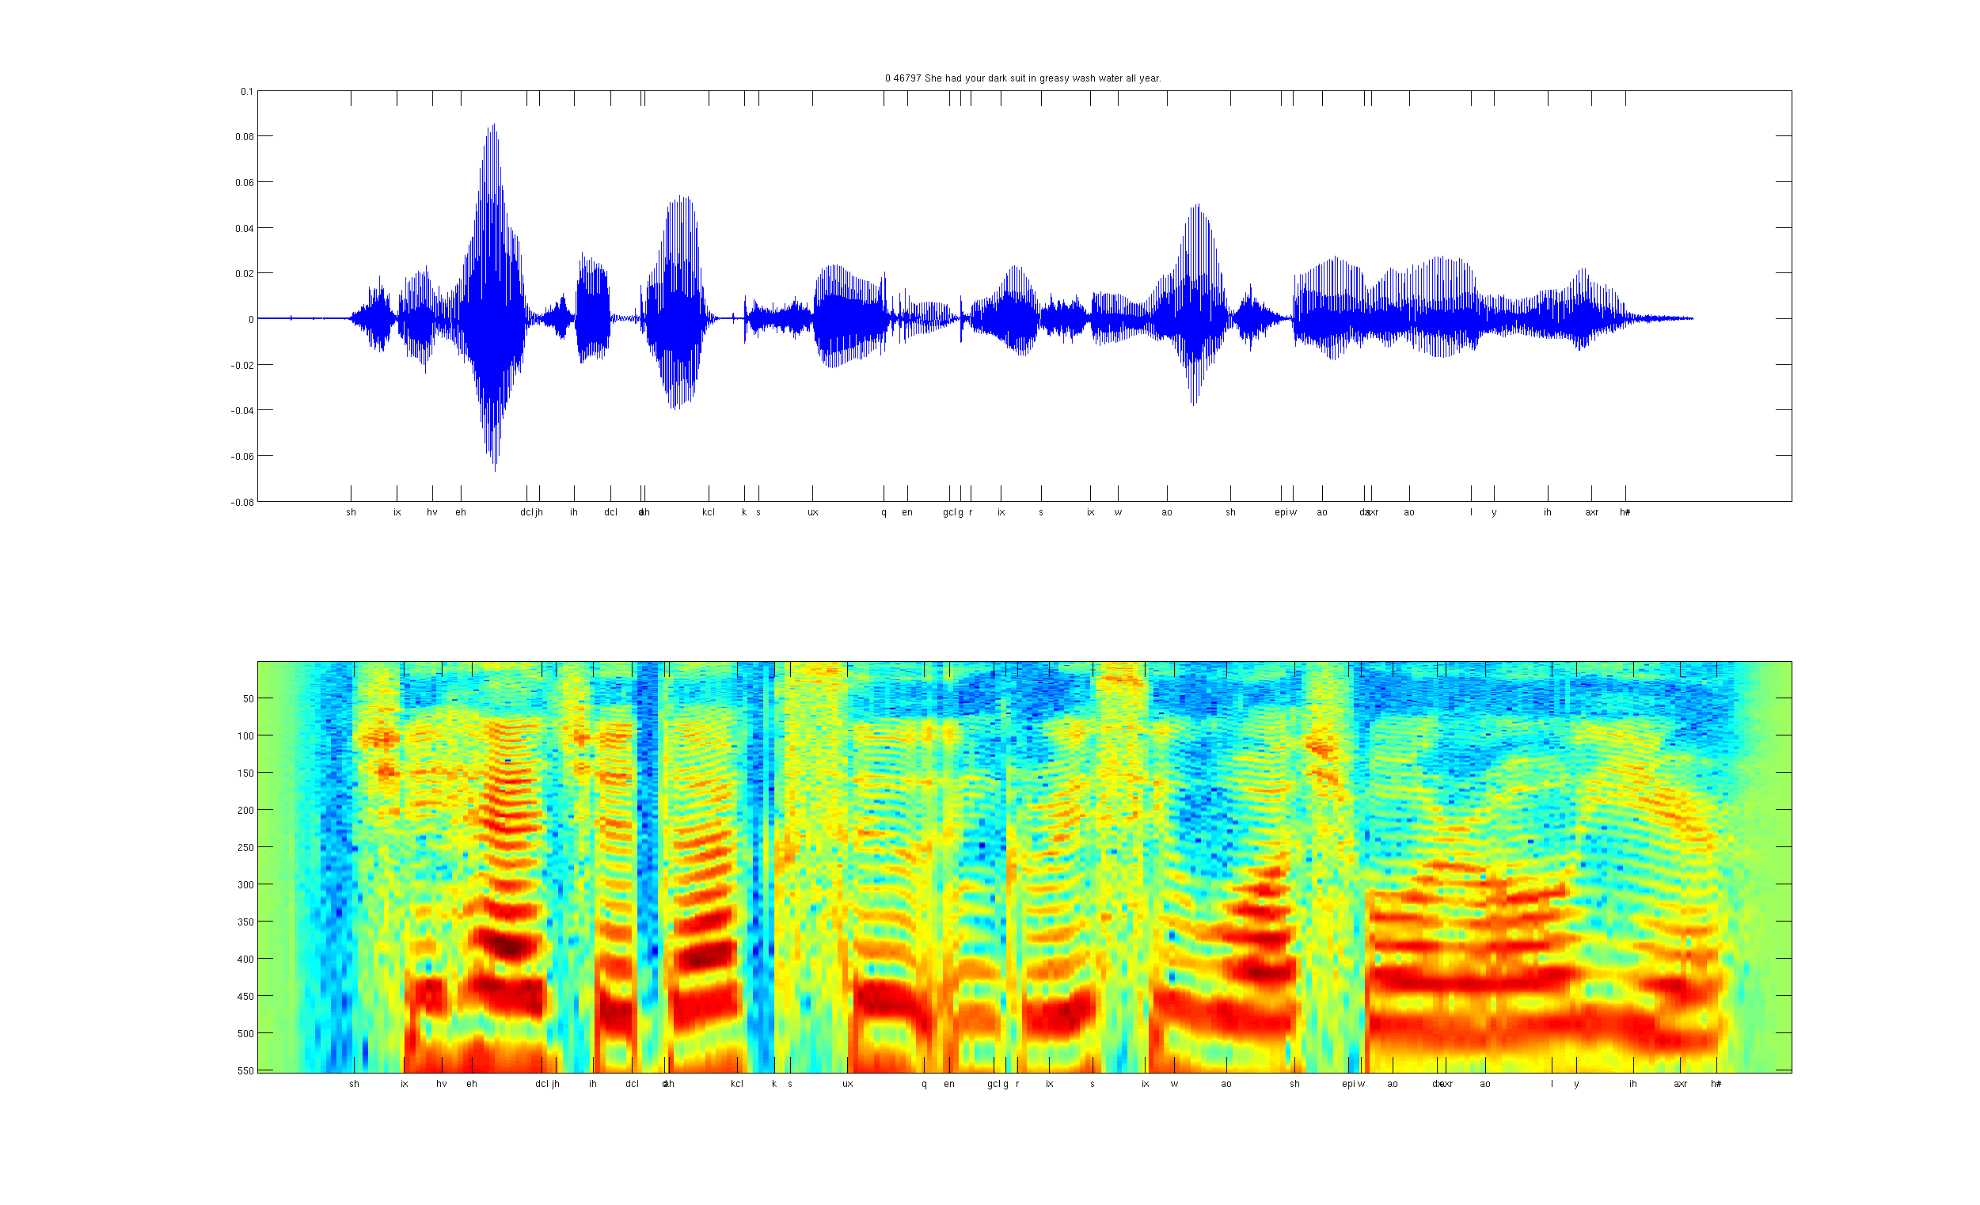
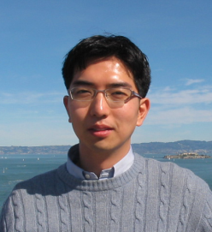
Computer Perception?
Human Created Features
Images/video
Image
Vision features
Detection
Image
Low-level features
Grasp point
Audio
Audio
Audio features
Speaker ID
[Andrew Ng]

Slide 49
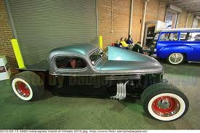
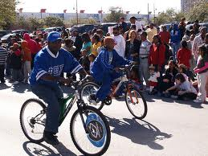
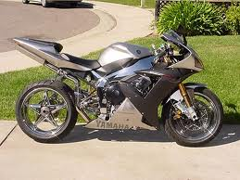
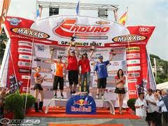
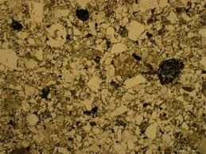
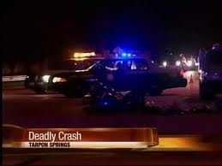
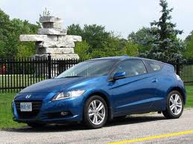
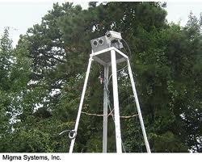
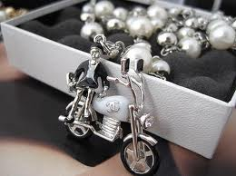
Not Perfect…
Motorcycle
Motorcycle
Motorcycle
Motorcycle
Motorcycle
Motorcycle
Motorcycle
Motorcycle
Motorcycle
Notes:
Good faith effort to implement state-of-the-art.
Cluttered scenes.

Slide 50
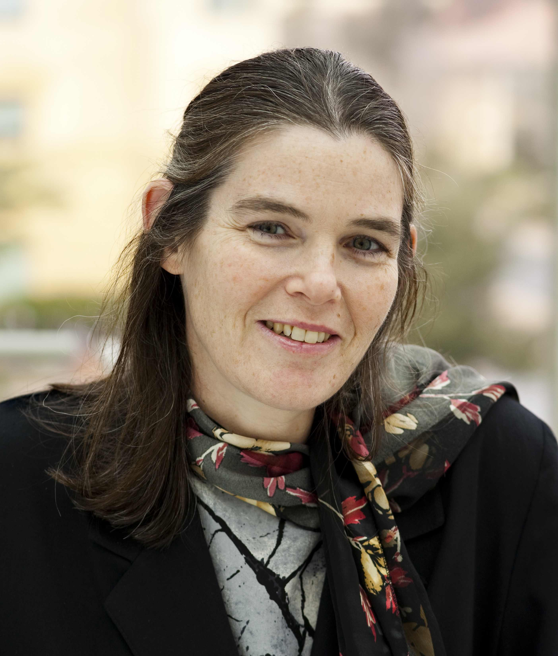
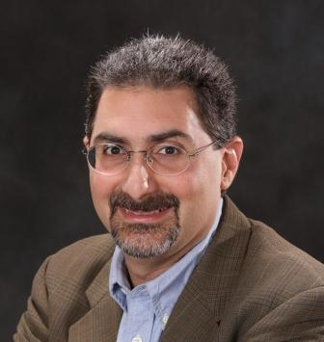
Some Great Thinkers
Daphne Koller
Mehran Sahami
Notes:
Good faith effort to implement state-of-the-art.
Cluttered scenes.

Slide 51
Two Great Ideas
1. Probability from Examples
2. Artificial Neurons

Slide 52
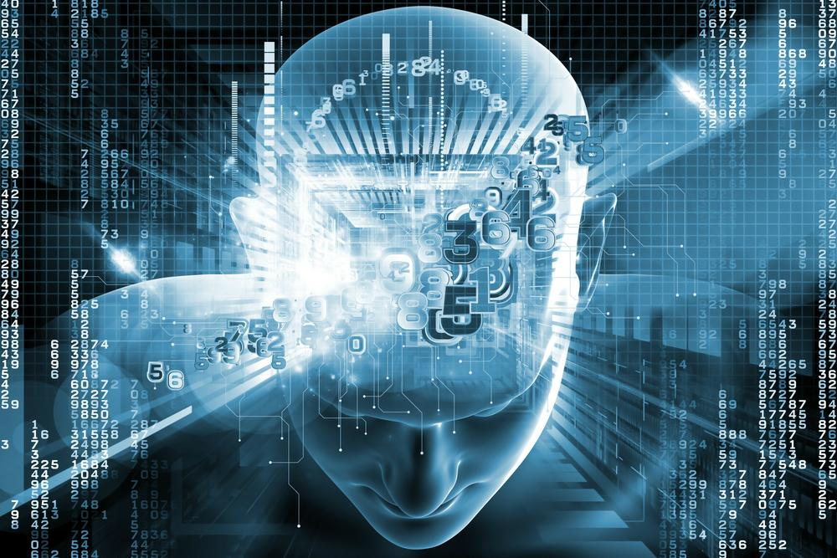
2. Artificial Neurons

Slide 53
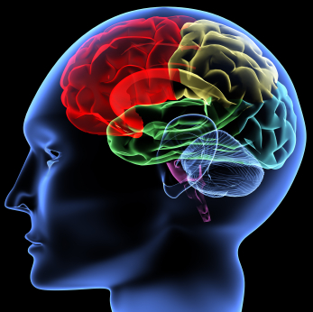
The hypothesis
One Algorithm Hypothesis
Much of perception in the brain can be explained with a single learning algorithm.
[Andrew Ng]

Slide 54

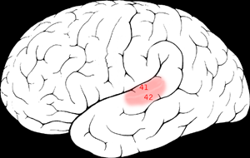

One Learning Algorithm
One Algorithm Hypothesis
Auditory Cortex
Auditory cortex learns to see
[Roe et al., 1992]
[Andrew Ng]

Slide 55


One Algorithm Hypothesis
Somatosensory Cortex
Somatosensory cortex learns to see
[Metin & Frost, 1989]
[Andrew Ng]

Slide 56






Sensor Representations
Seeing with your tongue
Human echolocation (sonar)
Haptic belt: Direction sense
Implanting a 3rd eye
[BrainPort; Welsh & Blasch, 1997; Nagel et al., 2005; Constantine-Paton & Law, 2009]

Slide 57

Neuron

Slide 58
Neuron

Slide 59
Neuron

Slide 60
Neuron

Slide 61
Some Inputs are More Important

Slide 62
Artificial Neuron
1
2
1
3
6
0.99
-2
0
1
1

Slide 63
Artificial Neuron
1
2
1
3
6
0.99
-2
0
1
1
input sum = 1 * 2 +
1 * 3 +
0 * -2 +
1 * 1

Slide 64

Sigmoid Function
1
2
1
3
6
0.99
-2
0
1
1
An artificial neuron is like a little probability calculator

Slide 65
Put Many Together

Slide 66
Put Many Together

Slide 67
Put Many Together

Slide 68
Put Many Together

Slide 69
Make It Useful

Slide 70

Make It Useful

Slide 71
Make It Useful

Slide 72
Make It Useful
This means it’s a picture of the number 4

Slide 73

Make It Useful
This means it’s a picture of the number 6

Slide 74
When We Are Wrong…
This means it’s a picture of the number 6

Slide 75
Adjust Weights
This means it’s a picture of the number 6

Slide 76


Visualize the Weights
object models
object parts
(combination
of edges)
Training set: Aligned
images of faces.
edges
pixels
[Honglak Lee]

Slide 77

Google Brain

Slide 78
Google Brain
1 Trillion Artificial Neurons

Slide 79

Watched YouTube

Slide 80


A Neuron That Fires When It Sees Cats
Top stimuli from the test set
Optimal stimulus
by numerical optimization
Le, et al., Building high-level features using large-scale unsupervised learning. ICML 2012

Slide 81


Slide 82





Other Neurons
Neuron 1
Neuron 2
Neuron 3
Neuron 4
Neuron 5
Le, et al., Building high-level features using large-scale unsupervised learning. ICML 2012
Input to another layer above
(image with 8 channels)
Number of output
channels = 8
LCN Size = 5
H
Pooling Size = 5
Number
of maps = 8
One layer
W
RF size = 18
Number of input
channels = 3
Image Size = 200

Slide 83

Autonomous Tutor

Slide 84


Prediction Results
Huge improvement in ability to predict for real students

Slide 85
Autonomous Tutor
Scatter plots
Pythagorean
theorem
Lines
Angles
Exponents
Systems of
Equations
Line graphs
Fractions

Slide 86
Not once, but twice, AI was revolutionized by people who understood probability theory.

Slide 87
End of Story

Slide 88
Probability is more than just machine learning

Slide 89

Abundance of Important Problems

Slide 90


Algorithms and Probability
Eg Raytracing
Eg HashMaps
Hash Fn

Slide 91



Medicine and Probability

Slide 92

Autocomplete

Slide 93


Probability in Practice

Slide 94


Philosophy and Probability

Slide 95


Art and Probability

Slide 96
#1 Most Desired Skill in Industry
Microsoft's competitive advantage, [Bill Gates] responded, was its expertise in "Bayesian [probabilistic] networks.“
(from Los Angeles Times, Oct. 28, 1996)
“The sexy job in the next 10 years
will be statisticians.”
Hal Varian, Chief Economist at Google
(from New York Times, August 6, 2009)

Slide 97
#1 Most Desired Skill in Industry
“I believe over the next decade computing will become even more ubiquitous and intelligence will become ambient. The coevolution of software and new hardware form factors will intermediate and digitize — many of the things we do and experience in business, life and our world. This will be made possible by an ever-growing network of connected devices, incredible computing capacity from the cloud, insights from big data, and intelligence from machine learning.”
-- Satya Nadella (CEO, Microsoft)
Email to all employees on first day as CEO (Feb. 04, 2014)

Slide 98
#1 Most Desired Skill in Academia
Most CS PhD students list their highest desiderata upon graduation as:
“Better understanding of probability”

Slide 99
Foundation for future classes

Slide 100
But its not always intuitive

Slide 101

Mammogram Test
Positive Mammogram.
What is the probability of cancer?
0.08% of women have breast cancer
90% positive rate for women with breast cancer
7% positive rate for women without breast cancer
The right answer is 9%

Slide 102
Probability = Important + Needs Study

Slide 103
What is CS109?

Slide 104

Traditional View of Probability

Slide 105

CS View of Probability
http://www.site.com
http://www.site.com
http://www.site.com
Give you the tools necessary to build and understand probabilistic CS algorithms.

Slide 106
Pedagogy
Give you the tools necessary to build and understand probabilistic CS algorithms.
Clarity of concepts
Proofs for extra depth
Motivation for narrative

Slide 107

Spring vs Winter?
Chris took first CS109 class

Slide 108
You are going to learn these tools.

Slide 109
Lets dive in…

Slide 110

Counting

